Slide 1

Boosting Profit for Grean Bean Coffee: Recommender Systems

Slide 2


Major Topics
Date
1.
Sales Performance
2.
Recommender Systems and Bots
3.
Projections
4.
Future Plans & Conclusion

Slide 3
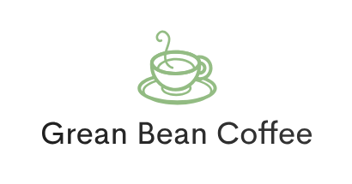
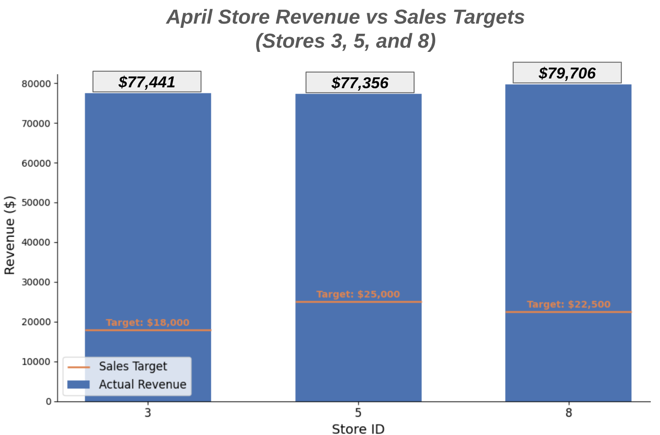
Locations
8 stores across New York:
Long Island City (1)
Brooklyn (1)
New York City (6)
Constraints
Recent system changes limit available data:
Only April Data Available
Limited Sales and Wastage Data (Stores 3, 5, 8)
Notes:
Draft, yes it sucks. Will put in a map of stores with pins and change background color

Slide 4
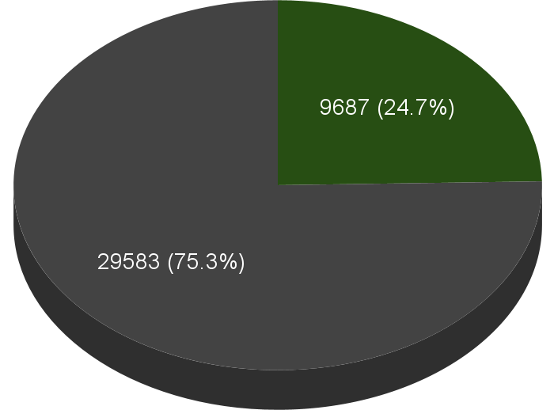
Single-Item vs Multi-Item Purchases
(Stores 3, 5, & 8)
75% of all sales include just one item
Multi-Item
Single-Item

Slide 5
Single-Item vs Multi-Item Purchases
(Stores 3, 5, & 8)
Untapped Potential!
Multi-Item
Single-Item

Slide 6
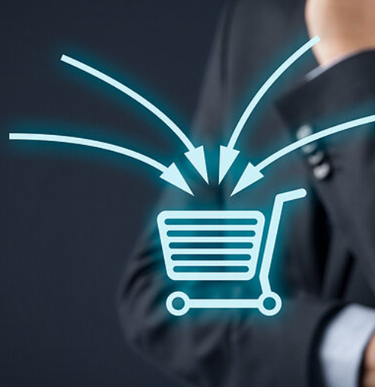
Upselling
Date
The goal is to push new items on small orders
Traditional Methods:
Advertising:
Staff Recommendation:

Slide 7
Upselling
Date
The goal is to push new items on small orders
Traditional Methods:
Advertising:
Rigid
Misses hidden trends
Staff Recommendation:
Inconsistent

Slide 8
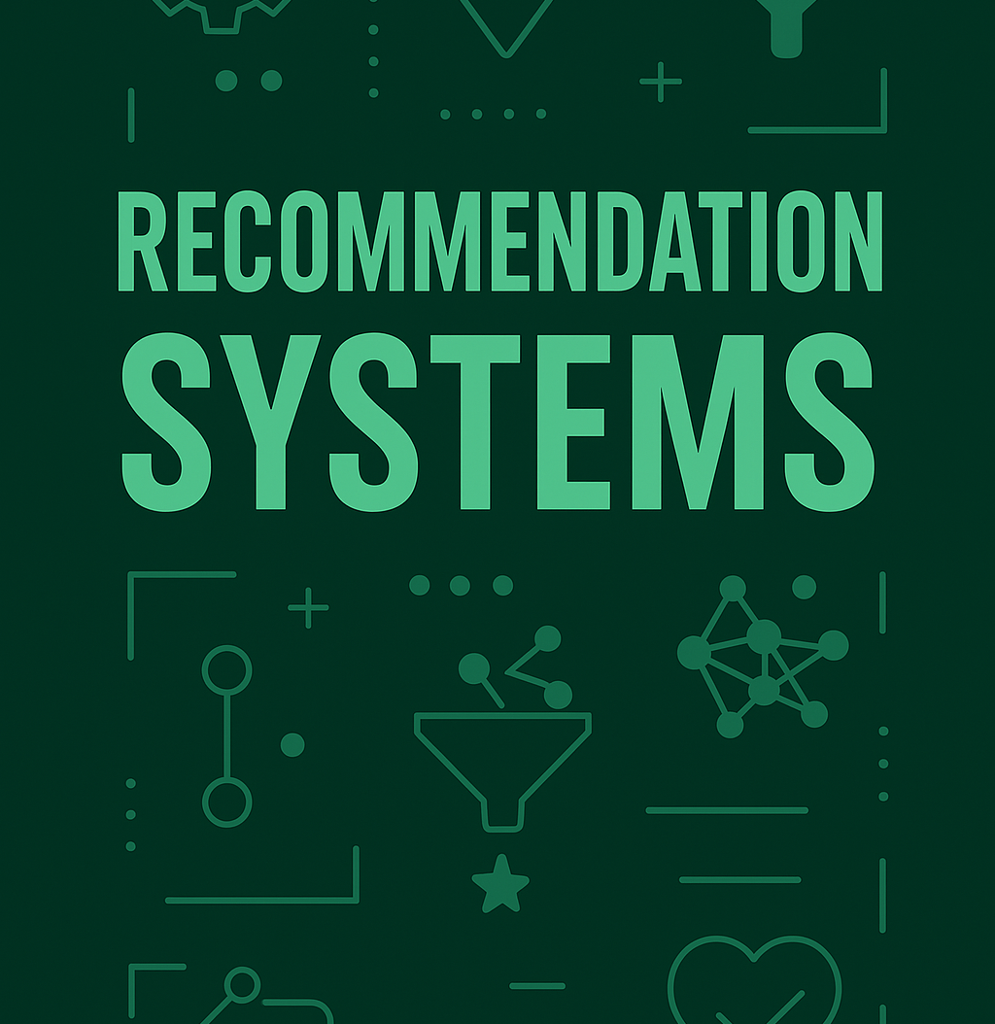
Upselling
The goal is to push new items on small orders
Traditional Methods:
Advertising:
Rigid
Misses hidden trends
Staff Recommendation:
Inconsistent

Slide 9
Upselling
Company Name
Machine Learning Tools for Pattern Detection
The goal is to push new items on small orders
Apriori Systems:
Recommends frequently associated products
Traditional Methods:
Advertising:
Rigid
Misses hidden trends
Collaborative Filtering Systems:
Recommends based on known customer behavior
Staff Recommendation:
Inconsistent

Slide 10
Performance on Limited Data
Multi-Item Orders for Training: 9687
Single-Item Orders for Upsell: 29583
Hit Rate = (Relevant Recs)/(Total Recs) * 100%
Item-Specific Recommender
Recommend Products by Name
Low
27.67%
High
31.06%
Average
29.48%

Slide 11
Performance on Limited Data
Multi-Item Orders for Training: 9687
Single-Item Orders for Upsell: 29583
Hit Rate = (Relevant Recs)/(Total Recs) * 100%
Item-Specific Recommender
Product Category Recommender
Recommend Products by Name
Recommend Products by Category
Low
27.67%
Low
83.58%
High
31.06%
High
85.70%
Average
29.48%
Average
84.75%

Slide 12
Performance on Limited Data
Multi-Item Orders for Training: 9687
Single-Item Orders for Upsell: 29583
Hit Rate = (Relevant Recs)/(Total Recs) * 100%
Item-Specific Recommender
Product Category Recommender
Product Category Recommender
(Advanced)
Recommend Products by Name
Recommend Products by Category
Uses feature engineering, clustering, and k-means to boost performance
Low
27.67%
Low
83.58%
Low
78.56%
High
31.06%
High
85.70%
High
84.43%
Average
29.48%
Average
84.75%
Average
81.77%

Slide 13
Bot Features (Non LLM)
Customer Order | Recommendation | Output
Coffee, Scone | Bakery, Syrup | Based on your order, you might also like: *Ginger Scone* — a delightful treat. Only $3.25! *Carmel syrup* — a delightful treat. Only $0.80!

Slide 14
Bot Features (Non LLM)
Customer Order | Recommendation | Output
Coffee, Scone | Bakery, Syrup | Based on your order, you might also like: *Ginger Scone* — a delightful treat. Only $3.25! *Carmel syrup* — a delightful treat. Only $0.80!
Tea | Bakery | Based on your order, you might also like: *Oatmeal Scone* — a delightful treat. Only $3.00!

Slide 15
Bot Features (Non LLM)
Customer Order | Recommendation | Output
Coffee, Scone | Bakery, Syrup | Based on your order, you might also like: *Ginger Scone* — a delightful treat. Only $3.25! *Carmel syrup* — a delightful treat. Only $0.80!
Tea | Bakery | Based on your order, you might also like: *Oatmeal Scone* — a delightful treat. Only $3.00!
Unknown | None | Have a great day!

Slide 16
Projected Average Revenue Boost
Assumptions
Number of single-item orders each month is unchanged (29583)
Just 10% of purchasing customers add a recommended item
Only considering Stores 3, 5, and 8
Average Product Price: $6.58
Average Product Cost: $3.89
Average Net: $3.89
Boosted Monthly Revenue Per Store
Percent Monthly
Boost
2.2K
+2.8%
Boosted Yearly Revenue (1 Store)
Boosted Yearly Revenue (3 Stores)
26K
79K

Slide 17
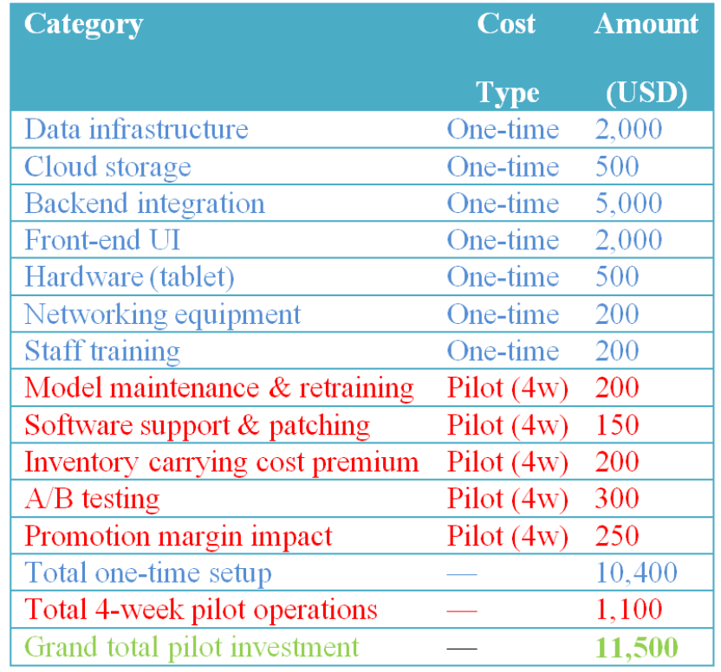
Cost Projections
Key Points
7 Months
Minimum Time to Full Integration
$11500
Estimated cost of implementation per store
5 Months
Estimated time to recoup investment after full integration

Slide 18
Summary
Consistent upselling at register could boost revenue, but traditional methods may be insufficient
Untapped Sales Potential
Majority of sales are single-item (75%)

Slide 19
Summary
Consistent upselling at register could boost revenue, but traditional methods may be insufficient
Untapped Sales Potential
Majority of sales are single-item (75%)
Category-Based Recommenders + Basic Chatbots
Combined category based apriori recommenders with basic chatbots for cost-effective item recommendations
Projected yearly boost to revenue averages +2.8% (~$26K per store on record)

Slide 20
Summary
Consistent upselling at register could boost revenue, but traditional methods may be insufficient
Untapped Sales Potential
Majority of sales are single-item (75%)
Category-Based Recommenders + Basic Chatbots
Combined category based apriori recommenders with basic chatbots for cost-effective item recommendations
Projected yearly boost to revenue averages +2.8% (~$26K per store on record)
Cost to Implement
Implementation takes time and money for each store adapted
$11500 per store to integrate over 7 months, with 5 more to recoup expenses (12 months for profit)

Slide 21
Next Steps
01
Data Acquisition
Obtain data for other stores, monthly expenditure data, other months

Slide 22
Next Steps
02
Model Refinement and Infrastructure
01
- Boost recommendation performance with newly acquired data.
- Product-Based Recommenders with more data (Optional)
- Prepare data infrastructure for recommender and integrate
Data Acquisition
Obtain data for other stores, monthly expenditure data, other months

Slide 23
Next Steps
03
02
Test Phase
Model Refinement and Infrastructure
- Trial runs and evaluation with final models
- Staff training on existing models and use cases (Optional)
01
- Boost recommendation performance with newly acquired data.
- Product-Based Recommenders with more data (Optional)
- Prepare data infrastructure for recommender and integrate
Data Acquisition
Obtain data for other stores, monthly expenditure data, other months

Slide 24

Next Steps
04
03
Full Deployment
02
Test Phase
- Launch model in all stores
- Continually update sales training data for up-to-date models
- Evaluate performance and net revenue
Model Refinement and Infrastructure
- Trial runs and evaluation with final models
- Staff training on existing models and use cases (Optional)
01
- Boost recommendation performance with newly acquired data.
- Product-Based Recommenders with more data (Optional)
- Prepare data infrastructure for recommender and integrate
Data Acquisition
Obtain data for other stores, monthly expenditure data, other months

Slide 25
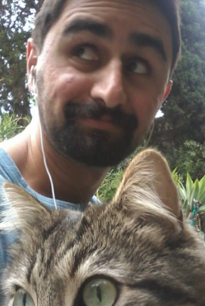

Contact
Joel Laskow
Samson Akomolafe
Linked In
Github
Email
Linked In
Github
Email

Slide 26
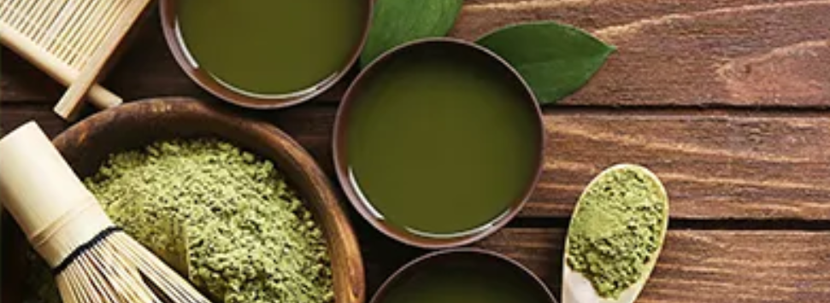

Thank you!

